Slide 1
Case Study Material for Agile - Scrum
Software Engineering (UE19CS302)

Slide 2
Presented By
B.Pravena – PES2UG19CS076 – Q1a => 20%
Batchu Sai Suraj – PES2UG19CS083 – Q1c => 22%
Bharath Kumar S P – PES2UG19CS087 – Q3 => 22%
Bhuvantej R – PES2UG19CS092 – Q2 => 18%
Balendra D P – PES2UG19CS100 – Q1b => 18%

Slide 3
Introduction
IT Sector is a gold mine for Service Inc and wants to increase it’s margins in this sector.
Service Inc decided to get into Product Engineering space as they believed it would help them increase their profits.
They wanted to increase their revenue by 25% and margin by 40% in the next 3 years.
Service Inc decided that if they could make Product Inc agree to handover the execution of a product of Product line roadmap for growing products on a revenue sharing process they would reach their targets.
The SVP’s of both the companies had a meeting and SVP of Product Inc mentioned the strengths and weaknesses of Service Inc and also promised to help Service Inc in reaching their targets.
Service Inc SVP decided to train his project managers, program managers, lead engineers in Agile and Scrum.
Stan(Program director of Product Inc ) gave 2 types of projects to the Service Inc.

Slide 4
One was maintenance projects in which they had to fix the bugs and the second one was to release minor versions of the projects that were shortly getting to discontinuance.
To understand the real status of the stakeholders he considered the feedback of the engineers as ground reality.  Stan took first week to get introduced to the stake holders.
He attended the sprint planning meeting, daily scrum meeting and sprint meetings too in order to know the status of progress happening in the next 4 weeks.
In the last 2 weeks he consolidated all his findings.
Each presentation had a go/no go recommendation at the conclusion.
The final decision was no go by Product Inc.

Slide 5
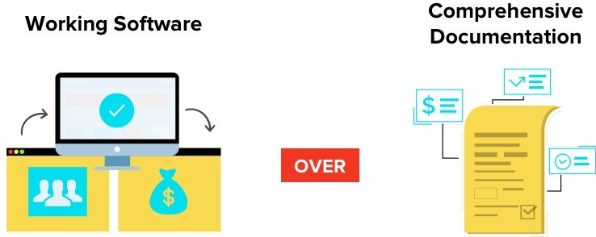
1a). Identify from the observations, where all would you think Service Inc did not meet the intent of the Agile Manifesto .
Service Inc maintained heavy documentation instead of having an effective working software.
They did not complete the working software in the expected timeframe as the backlog at the beginning of the scrum was more ambitious than the average velocity of the scrum teams.

Slide 6
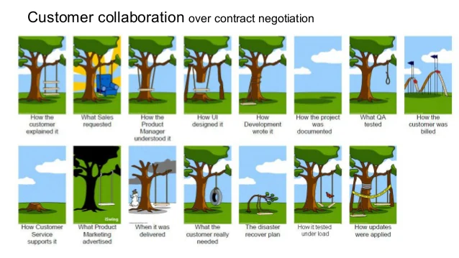

Product owners had never met a customer ever since the centers had been set up.
Instead of focusing on simple ways to explain about the completed tasks they had detailed presentation on the just concluded sprint.

Slide 7
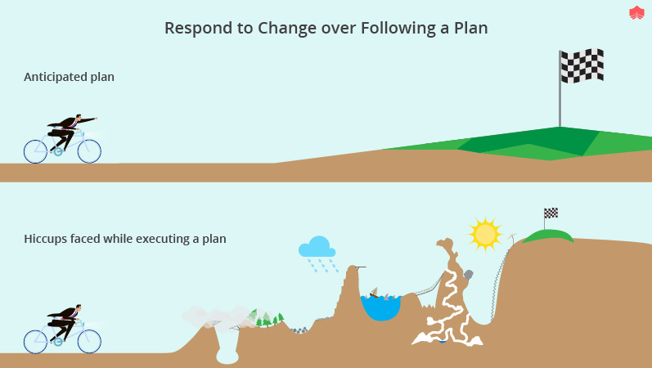
The team members had meeting for a longer time than the required time.
The backlog changes which had to get over before the sprint, underwent changes till 3rd week.
The quality engineers who had to join during the 1st week joined only after 2 weeks.
The work which had to be assigned by project manager was done by the scrum master.
The test engineers who had to write test cases earlier delayed it till the 3rd week.
The task list which had to be finalized at the beginning of the week was delayed till the end of the week.

Slide 8
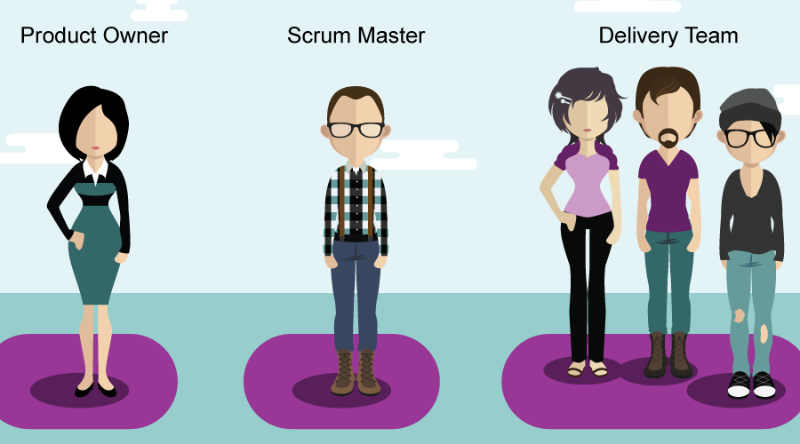
1b. Identify from the observations, where all would you think Service Inc deviated from, what is expected from a SCRUM implementation
1) Scrum Master and Product owners are rotated across sprints.
2)Daily scrum meetings usually took more than an hour than the expected 15 minutes time-box
3)Two test engineers are assigned among the development teams which is a clear violation of scrum framework and shows structure of sub-teams
4) Idleness and inefficiency as the test engineers were actually doing their only assigned work on the 3rd week of every sprint as there was nothing ready for testing.
5)The scrum master should not assign work to developers but facilitate them for self organisation

Slide 9
6) Scrum master making commitment on behalf of the team
7)Convincing and motivating the development team on commitments made by the scrum master violates the whole point of a sprint planning
8)The sprint backlog which contains the priorities of the product goal was delayed until the third week.
9)It is a clearly known that the scrum master has to take responsibility of the product issues so as in order to protect the scrum development team in order to not affect their efficiency
10)The whole Scrum Team should collaborate to define a Sprint Goal that communicates why the Sprint is valuable to stakeholders instead of the product owner first approaching the stakeholder
11) Manager has the team of 200+ members

Slide 10
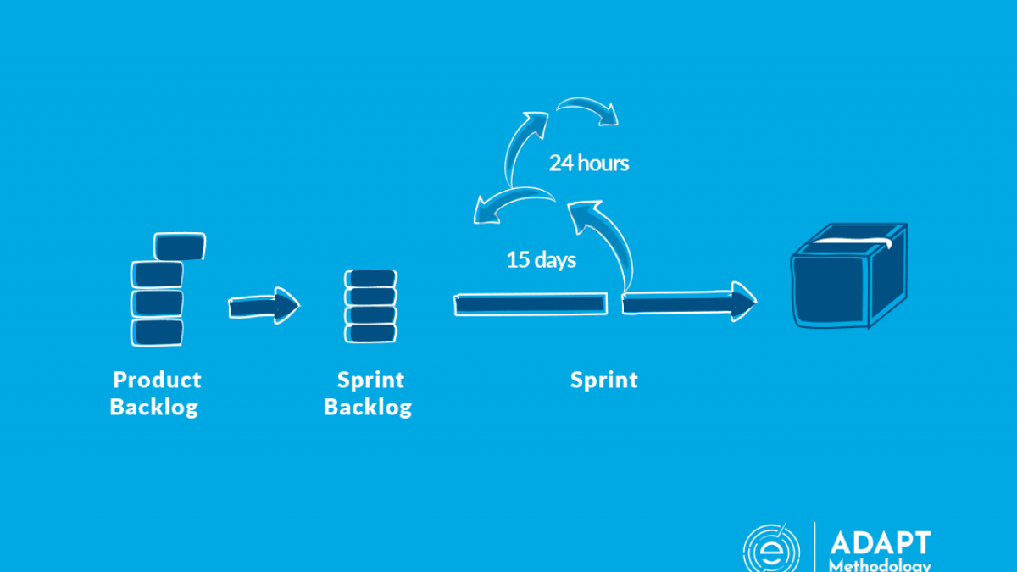
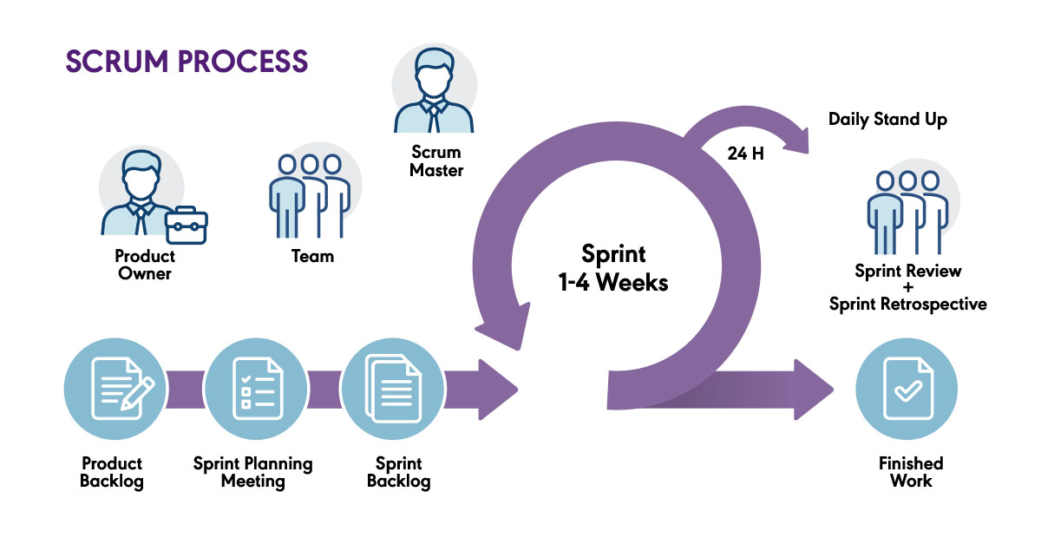

Slide 11
1c)Discuss each of the findings in the table and indicate whether the finding contributed positively or negatively in go/no go recommendation and indicate with ~5 sentences why it is so.
They can decrease the time to 25-30 min from 60-90 minutes because if they exclude all the unnecessary discussions they could save time.NO GO
that software should be tested on an iteration by iteration basis.NO GO
Project Manager is responsible for assigning tasks ,keeping track of tasks and to make commitments on behalf of the team.NO GO
The sprint backlog is prepared beforehand and therefore cannot undergo changes during the sprint.NO GO
This is because sprint review meetings are necessarily done to verify whether the sprint backlog is fulfilled or not and this is an very important step.GO

Slide 12
The list of tasks is a draft before the start of sprint and is finalized at the end of 1st week of the sprint.NO GO
The uncompleted items are again moved back to the Product Backlog and are again prioritized from there which increases work on the next sprint and hence it takes more time to complete the product development cycle than estimated time.NO GO
The product owners never met a customer for reviews which is against scrum principle which is customer collaboration.NO GO

Slide 13
2) How can Service Inc achieve 40% growth in margin while achieving only a 25% growth in revenue?
Service Inc’s revenue was growing steadily at 12%, whereas the margin was growing at 10%.
To achieve greater margin and revenue, they entered product engineering space, as consulting business was not scalable.
The Product Inc believes that for a pure product engineering operation (i.e., agile operation) wanted Service Inc engineers to learn Agile methodologies for smooth and profitable work.
So, it came to the point that Service Inc should become agile and follow one of its methodologies like SCRUM principles to reach to its target.

Slide 14
The SCRUM principles included :-
Control over the empirical process
Self-organization
Collaboration
Value-based prioritization
Timeboxing
Iterative development.
An internal process quality team was roped in for this transition, most employees underwent training of these methodologies.

Slide 15
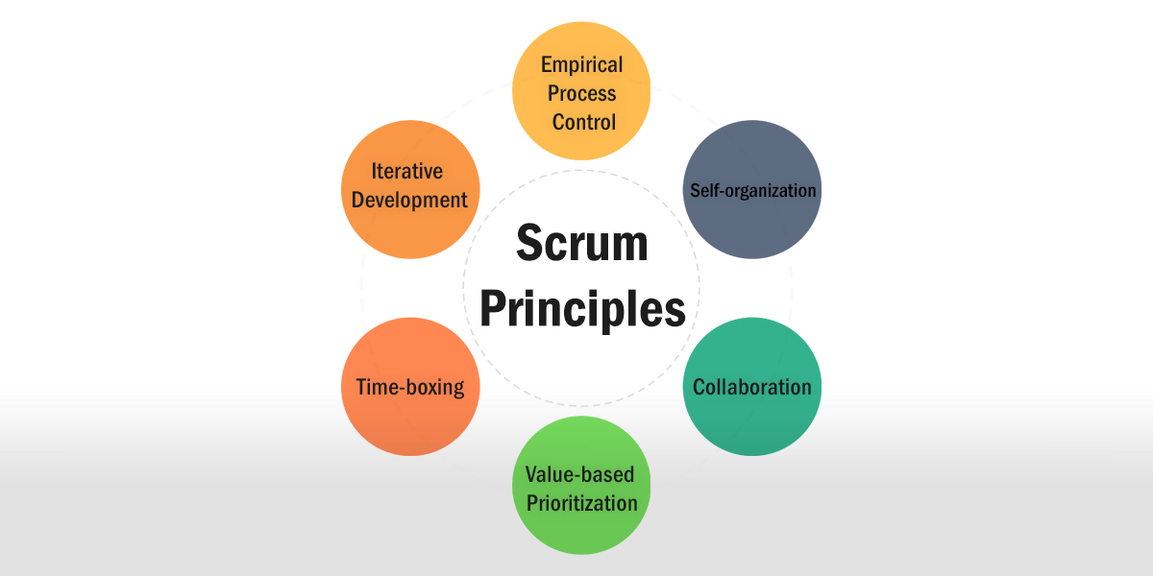
In this way, Service Inc can achieve 40% growth in margin and 25% growth in revenue.

Slide 16


3) What are the cultural differences between Service Inc and Product Inc that you think is a challenge for successful scrum implementation that would satisfy Product Inc.
PRODUCT INC
SERVICE INC
v/s

Slide 17
Service Inc Failed in…
Even though, Service Inc had set up multiple centres with many product companies.
But limited themselves to customer support.
Projects was mostly building discontinued or near End-Of-Life products.

Slide 18

Strength turned to be the WEAKNESS:
Service Inc had:
Trained project managers
Skilled program managers
Had extensive documentation team

Slide 19
These strengths of Service Inc, was simply not agile.
Because, in agile-product development, a company should be prepared to undergo any sudden uncertainty and constant change but not to rely entirely on documentation.

Slide 20


Misunderstanding and Failing to adapt:
During the switch, there has to be a proper transition throughout the teams, departments, etc.
Loss of authority.
Mistaking the role of Project Manager with Scrum Master.

